Slide 1
FX Material Techniques#1
Reproduce MHW’s “Fade By Emitter Angle” on UE4
using Unreal Engine 4 for game fx artist

Slide 2
Who am I?

Slide 3

Who am I?
Twitter: https://twitter.com/moko_03_25
Pinterest: https://www.pinterest.jp/moko_vfx/boards/
I’m a Japanese fx artist who has developed several video games:
PS2, PSP, 3DS, PS3, PS4, XboxOne and so on.
And I’m studying English.

Slide 4
Who am I?
!
I’m sorry if there are mistakes in this presentation.

Slide 5
What is “Fade By Emitter Angle”?

Slide 6

What is “Fade By Emitter Angle”?
http://www.capcom.co.jp/monsterhunter/world/
©CAPCOM CO., LTD. 2018 ALL RIGHTS RESERVED.
It’s one of the techniques used in “MONSTER HANTER WORLD.”

Slide 7


What is “Fade By Emitter Angle”?
https://cedec.cesa.or.jp/2020/
https://cgworld.jp/
It was featured in “CGWORLD,” the only CG-related
monthly magazine in Japan, and at “CEDEC,”
largest game developer’s conference in Japan.

Slide 8
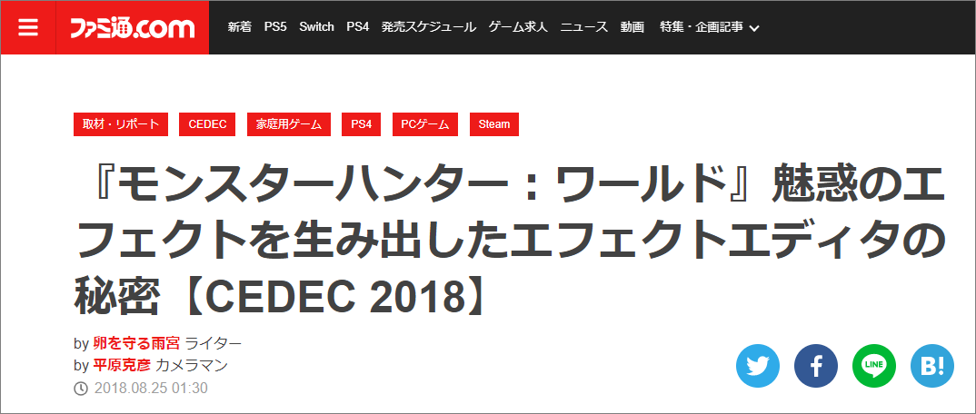
What is “Fade By Emitter Angle”?
https://www.famitsu.com/news/201808/25162914.html
A talk on MHW’s FX was given at “CEDEC 2018” and was also
written about by Japanese media.
Many valuable FX tehniques were spoken of.

Slide 9
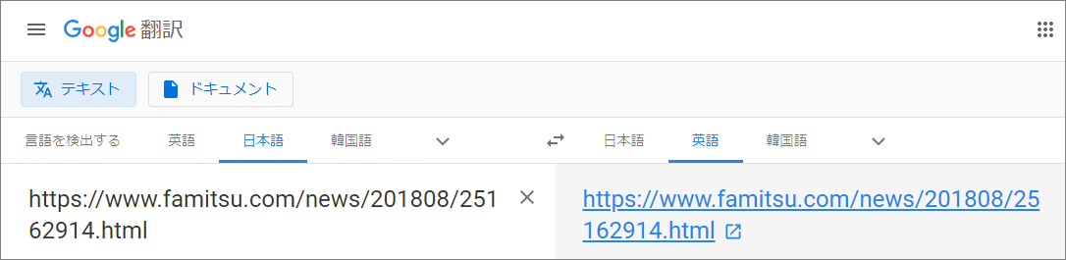
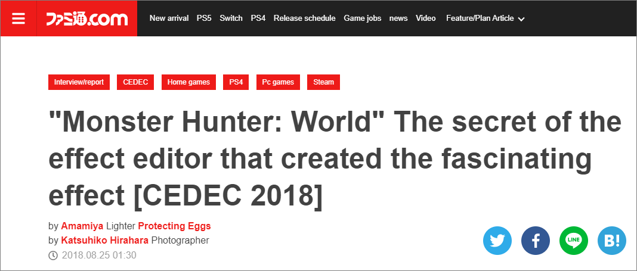
What is “Fade By Emitter Angle”?
Japanese
English
Can’t read Japanse? Try Google Translate!

Slide 10

What is “Fade By Emitter Angle”?
Login
Sign Up
Search
https://cedil.cesa.or.jp/
One more thing, the presentation materials given at “CEDEC”
can be download at “CEDiL.”
It’s free, although registration is required.

Slide 11
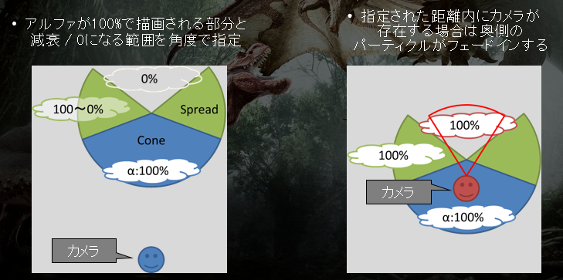
What is “Fade By Emitter Angle”?
https://cedil.cesa.or.jp/cedil_sessions/view/1893
Here’s the page where you can download the PPT about MHW FX.
You can also check out “Fade by Emitter Angle.”

Slide 12
What is “Fade By Emitter Angle”?
What technique is that?

Slide 13
What is “Fade By Emitter Angle”?
Top View
When particles are generated
in the form of a ring by a emitter...

Slide 14
What is “Fade By Emitter Angle”?
Fade out the particles on the
far side from the camera.

Slide 15
What is “Fade By Emitter Angle”?
？
However, if the camera is in the center,
you won’t be able to see anything...

Slide 16
What is “Fade By Emitter Angle”?
So it will return the Opacity of the
particles that was fading out to 100%.

Slide 17
What is “Fade By Emitter Angle”?
In addition, if the particles’ Opacity is 0,
they will be set to “non-coordinates”
to reduce the drawing load.

Slide 18
What is “Fade By Emitter Angle”?
This is the “Fade by Emitter Angle.”
So... when is it used?

Slide 19
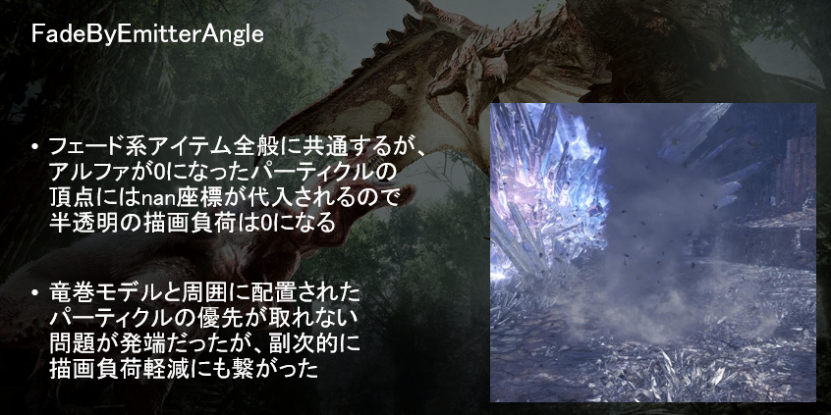
What is “Fade By Emitter Angle”?
https://cedil.cesa.or.jp/cedil_sessions/view/1893
An example of its use in smoke around a tornado was spoken of.

Slide 20
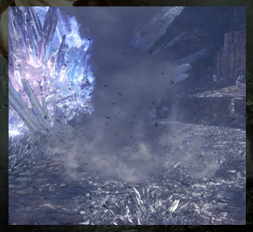
What is “Fade By Emitter Angle”?
I’m going to illustrate this in shapes.

Slide 21
What is “Fade By Emitter Angle”?
Emitter A
Emitter B
Typically, these tornade and the surrounding smoke
are composed of separate emitters.

Slide 22
What is “Fade By Emitter Angle”?
A -> B
B -> A
But either way, it looks unnatural...

Slide 23
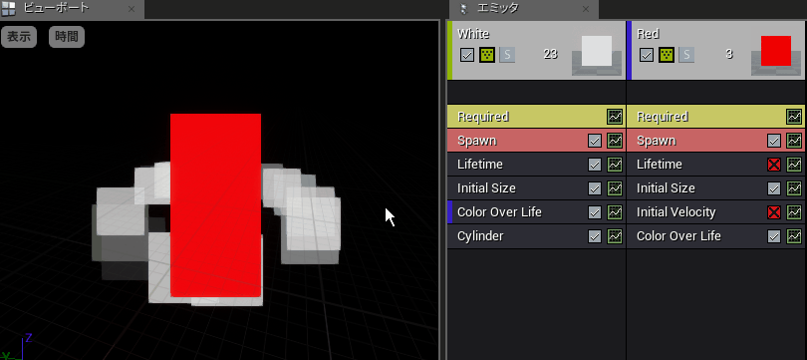
What is “Fade By Emitter Angle”?
I configured it in the same way with UE4.
It’s no good.

Slide 24
What is “Fade By Emitter Angle”?
A -> B
However, the “Fade By Emitter Angle”
solves the problem.
How wonderful!

Slide 25
Let’s recreate it on UE4!

Slide 26
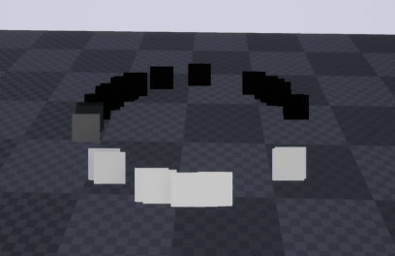
Let’s recreate it on UE4!
I tried to replicate that technique on UE4. (You can view the video in a slideshow.)

Slide 27
Let’s recreate it on UE4!
Now let me explain.

Slide 28
Let’s recreate it on UE4!
To put it briefly, find the “Dot Product” of
the two vectors and use it for Opacity.

Slide 29
Let’s recreate it on UE4!
What are the two vectors?

Slide 30
Let’s recreate it on UE4!
Vector 1:
This is the vector from the center of the
emitter to the position of each particle.

Slide 31
Let’s recreate it on UE4!
Vector 2:
This is the vector from the center of the
emitter to the position of the camera.

Slide 32
Let’s recreate it on UE4!
Yes, you can find it in the same way
as “Lambert Shading,” by dot product.

Slide 33
Let’s recreate it on UE4!
First, how to find the “Vector 1”.

Slide 34
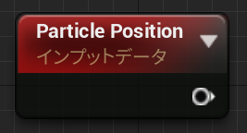
Let’s recreate it on UE4!
“Particle Positon” node is used to get the position of the particle.

Slide 35
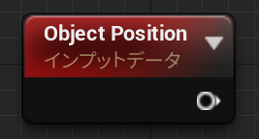
Let’s recreate it on UE4!
“Object Positon” node is used to get the position of
the center of the bounding box.
(It might be better to use the “Actor Position” node.)

Slide 36
Let’s recreate it on UE4!
It’s obtained by subtracting the two vectors.
→
→
→
a - b = c
b
ｃ
a

Slide 37
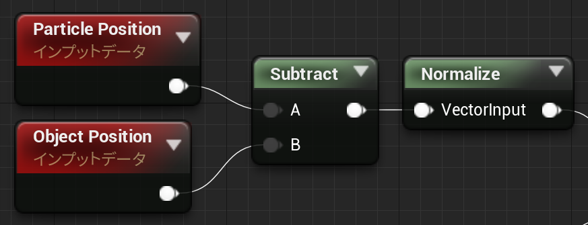
Let’s recreate it on UE4!
And the composition of the material on UE4 is so simple.

Slide 38
Let’s recreate it on UE4!
Don’t forget about normalization.

Slide 39
Let’s recreate it on UE4!
Second, how to find the “Vector 2”.

Slide 40
Let’s recreate it on UE4!
Simply use the vector directly
behind the camera.

Slide 41
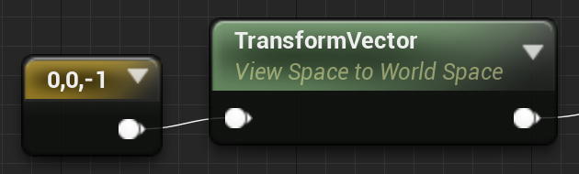
Let’s recreate it on UE4!
You can do this simply by using View Space.

Slide 42
Let’s recreate it on UE4!
x=0, y=0, z=-1
Probably something like this.
And you don’t need to
normalization because
it’s already normalized.
View Space

Slide 43
Let’s recreate it on UE4!
Then you need to convert it to World Space.

Slide 44
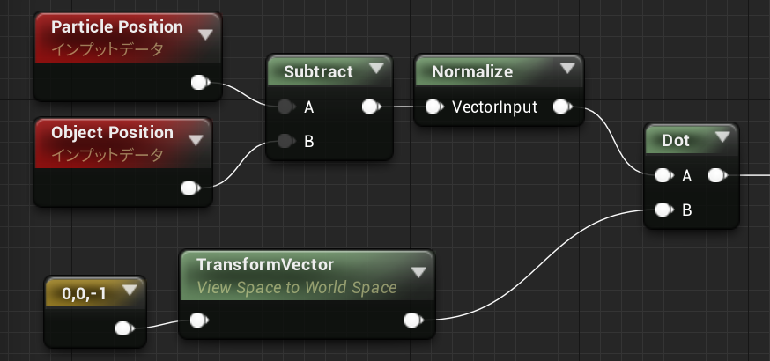
Let’s recreate it on UE4!
And finally, you find the dot product of the two vectors.

Slide 45
Let’s recreate it on UE4!
-1
The result looks like this.
0
1

Slide 46

Let’s recreate it on UE4!
0
However,
this is how we want to control it.
1

Slide 47
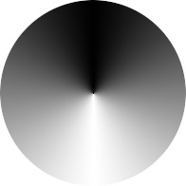
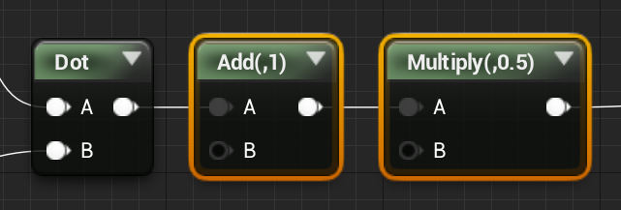
Let’s recreate it on UE4!
0
Then first correct the gradient from 1 to 0.
1

Slide 48
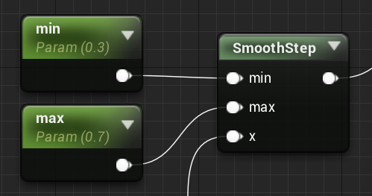
Let’s recreate it on UE4!
min
Next, you can use the “SmoothStep”.
0
1
max
return smoothstep(min, max, x);

Slide 49
Let’s recreate it on UE4!
Done!
(You can view the video in a slideshow.)

Slide 50
Let’s recreate it on UE4!
Are you finished now?
No, it’s not enough.

Slide 51
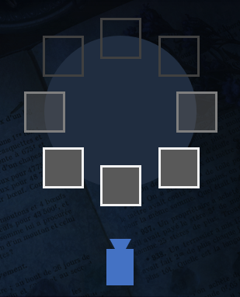
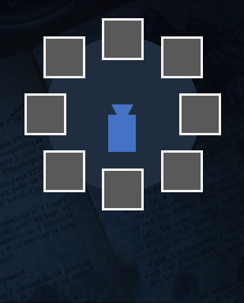
Let’s recreate it on UE4!
When the camera is inside the emitter,
you need to show the particles at the back side.

Slide 52
Let’s recreate it on UE4!
We FX artist often let the particles fade out
when they approach the camera.
It’s commonly known as “Camera Fade” in Japan.

Slide 53
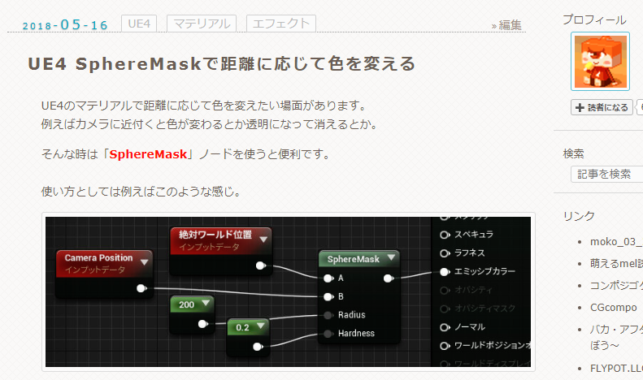
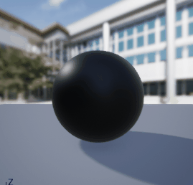
Let’s recreate it on UE4!
This technique can be found on the my blog (but in Japanese).
http://effect.hatenablog.com/entry/2018/05/16/025859

Slide 54
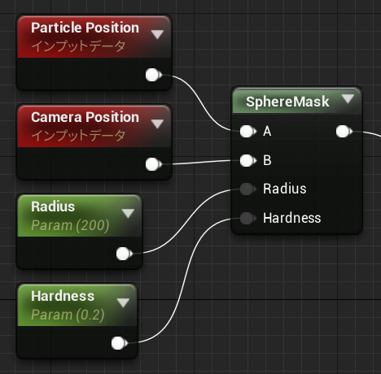
Let’s recreate it on UE4!
And you just need to configure it so
that the result is the opposite of a
camera fade.

Slide 55
Let’s recreate it on UE4!
In addition, let’s eliminate the drawing load of
completely transparent particles.

Slide 56
Let’s recreate it on UE4!
Here you’ll simply substitute each vertex of the particle
by moving it in one place.

Slide 57
Let’s recreate it on UE4!
Specifically, the vector from each vertex of the particle
to the center of the particle, is given to “World Position Offset.”

Slide 58
Let’s recreate it on UE4!
Then, only move it aroung the center of the vertex
when the Opacity is 0,
and do nothing when the Opacity is more than 0.

Slide 59
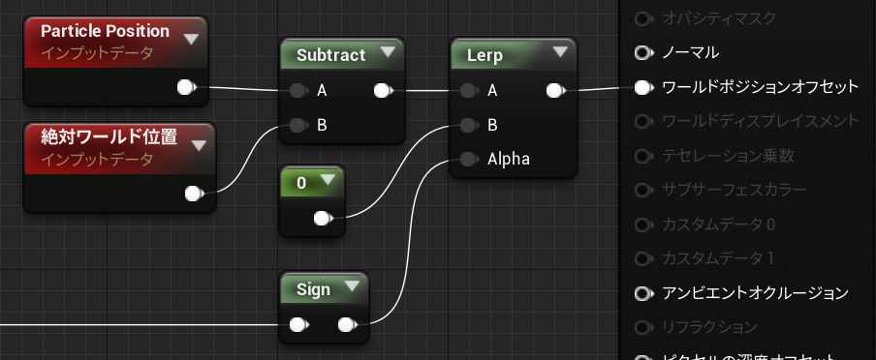
Let’s recreate it on UE4!
So this is how it’s structured.
World Position Offset
Absolute World Position

Slide 60
Let’s recreate it on UE4!
Get the vector from each vertex to the center of the particle.
World Position Offset
Absolute World Position

Slide 61
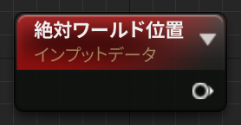
Let’s recreate it on UE4!
“Absolute World Position” is processed per vertex
when used in the vertex shader.
Absolute World Position

Slide 62
Let’s recreate it on UE4!
How do we process only when Opacity is 0?

Slide 63
Let’s recreate it on UE4!
There is a way to use “Sign” without using “If.”
a value between 0 and 1

Slide 64
Let’s recreate it on UE4!
“Sign” returns...
-1 when it receives a negative value,
1 when it receives a positive value, and
0 when it receives a value of 0.
Wataru Ikeda of Naughty Dog also spoke at CEDEC2018.
https://cedil.cesa.or.jp/cedil_sessions/view/1832

Slide 65
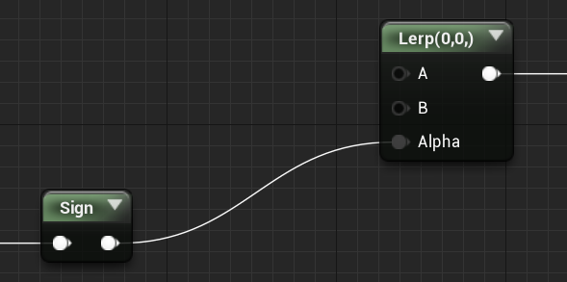
Let’s recreate it on UE4!
The process of A in “Lerp” is executed only when
the value of 0 is inputed into “Sign.”
Processing at 0
Processing at 1
a value between 0 and 1
0 or 1

Slide 66
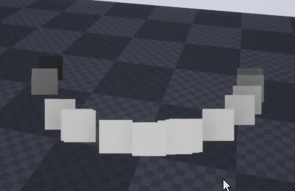
Let’s recreate it on UE4!
Done!
(You can view the video in a slideshow.)

Slide 67
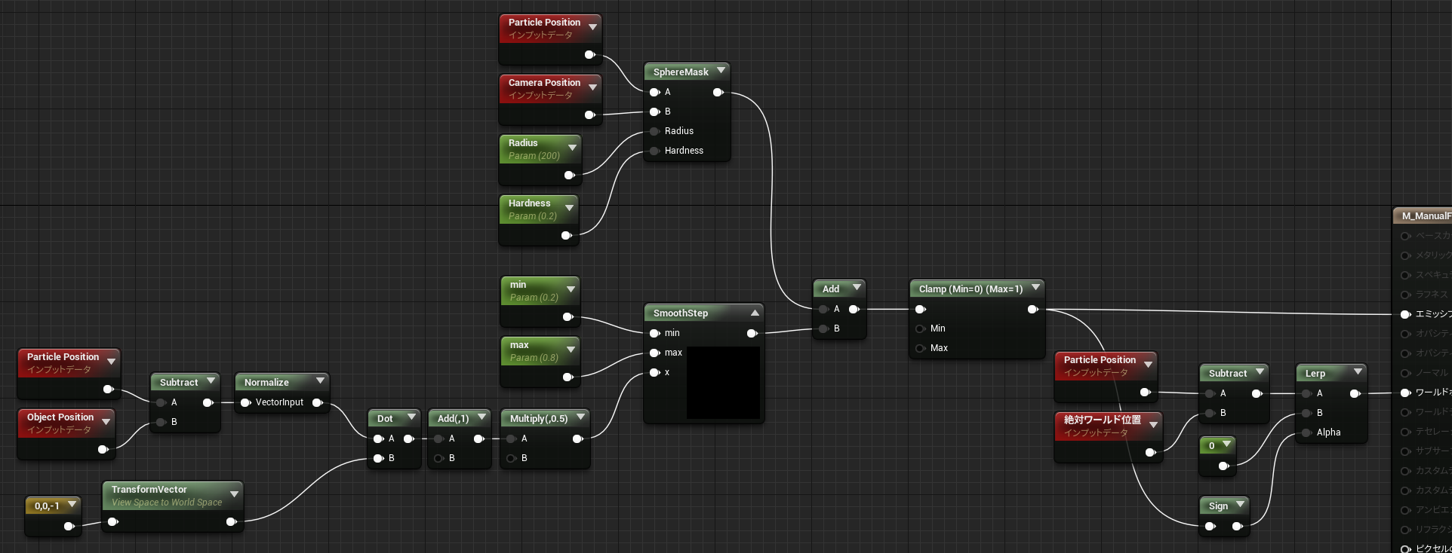
Let’s recreate it on UE4!
The structure is pretty simple, right?
Absolute World Position

Slide 68
Let’s recreate it on UE4!
Also, adding a “Camera Fade” would be better.

Slide 69
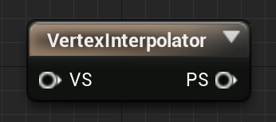
Let’s recreate it on UE4!
If the particle fade can be per vertex,
you could use “VertexInterpolator” to reduce the drawing load.

Slide 70
Let’s recreate it on UE4!
The explanation on this presentation does not need to be
calculated for every pixel where the material is drawn.
1. Fading out the particles based on its position with the camera.
2. If the particle’s Opacity is 0, the scale is 0.

Slide 71
Let’s recreate it on UE4!
I think that such a process can be done in a module
for particles using Niagara.

Slide 72
Let’s recreate it on UE4!
This concludes the explanation.
(And “DeepL Translate” has given me great help.)

Slide 73

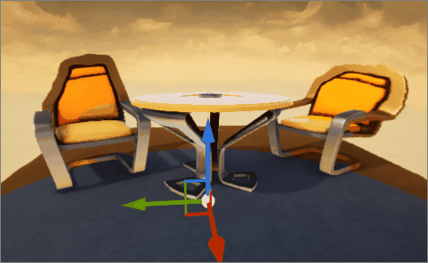
Root Growth FX
https://effect.hatenablog.com/entry/2019/11/04/194547
I have a post on my blog about the presentation of the FX
in “Devil May Cry 5,” in both Japanese and English,
if you’d like to check it out!

Slide 74
Thank you for watching! :)
Special Thanks : Nori Shinoyama / Kaz Okada / @Rakuraku91 / @com04

